Slide 1


Computer Programming internship presentation
By Shane Dugan
7/1/20

Slide 2
Website

Slide 3

The Design
Color
Layout

Slide 4
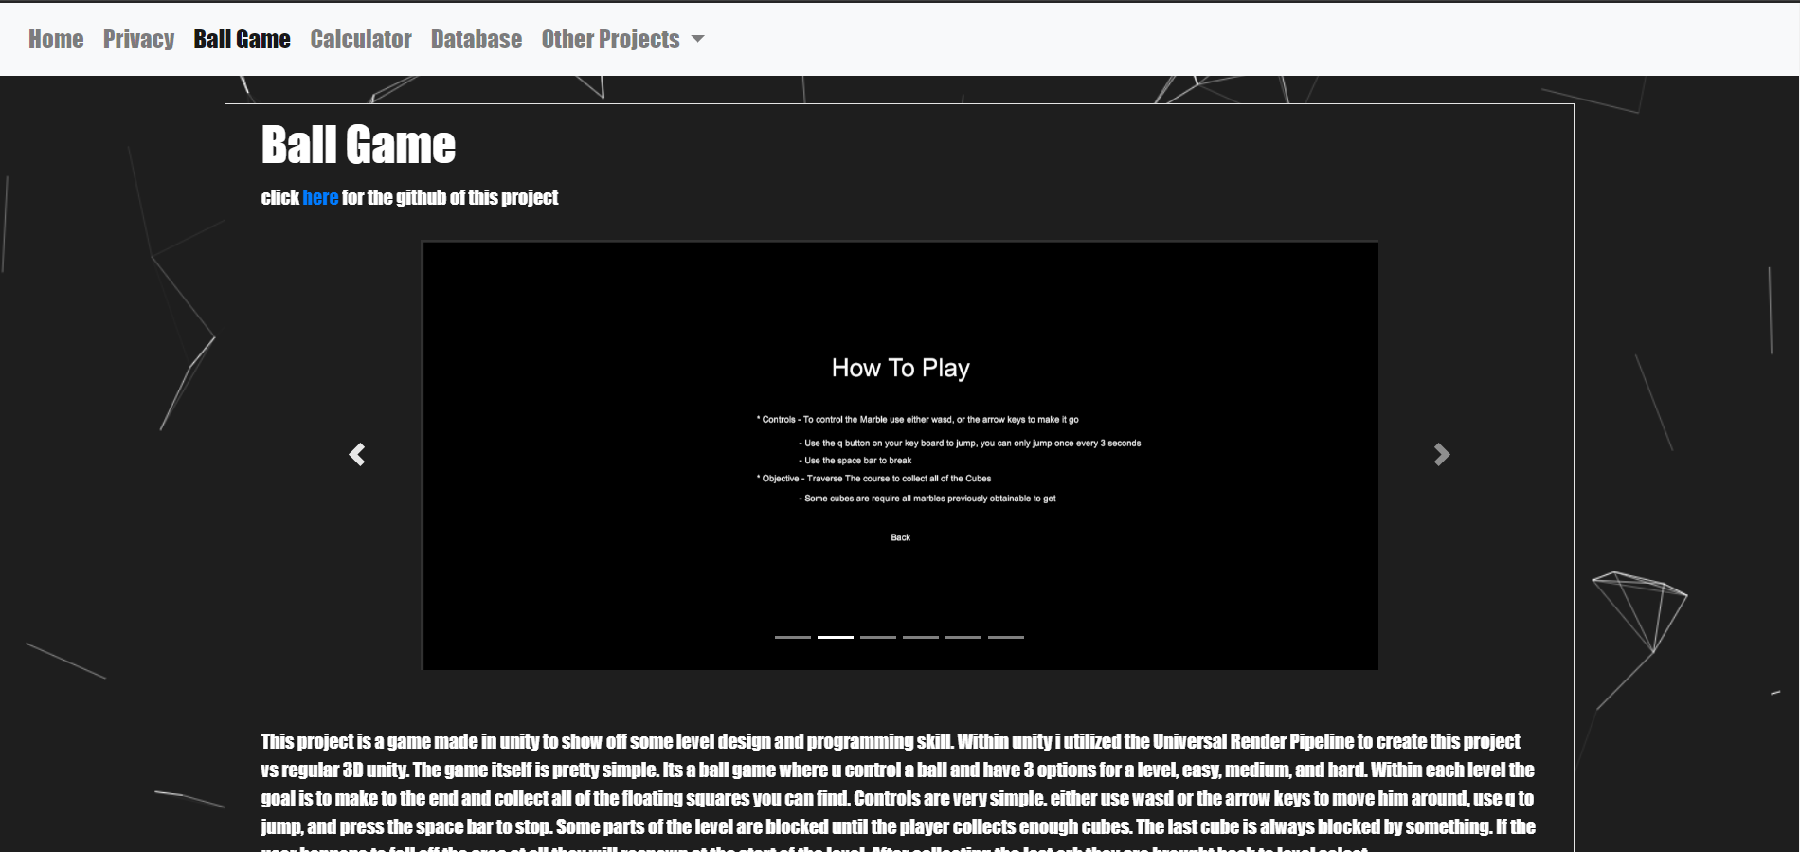
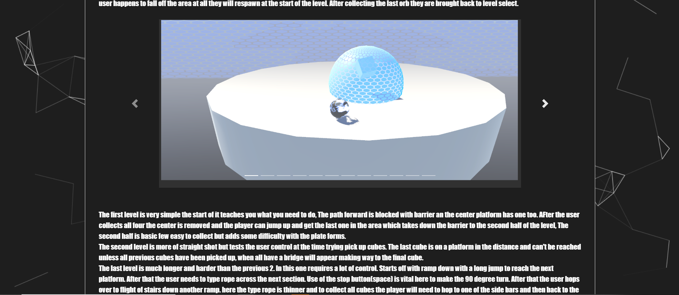
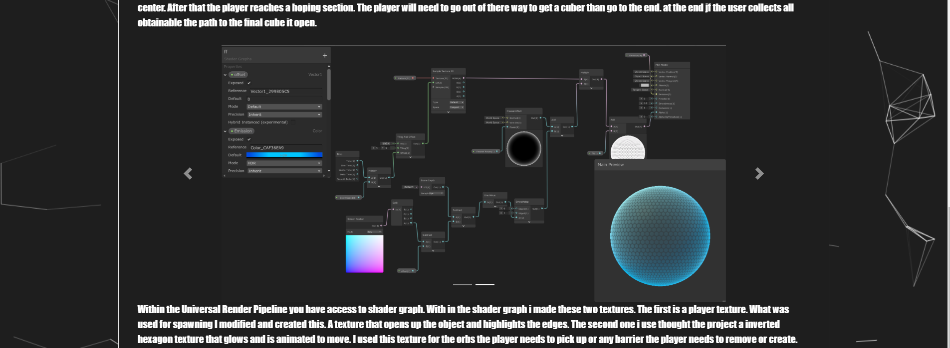
Other Features
Project pages
Text position
images

Slide 5
Project 1
Tri calculator

Slide 6
What it is?
Java frame
Radio buttons
Combo boxes
text fields
Calculator
Solve the sides of triangle with trig an Pythagorean theorem
Solve the angles of a triangle with trig

Slide 7
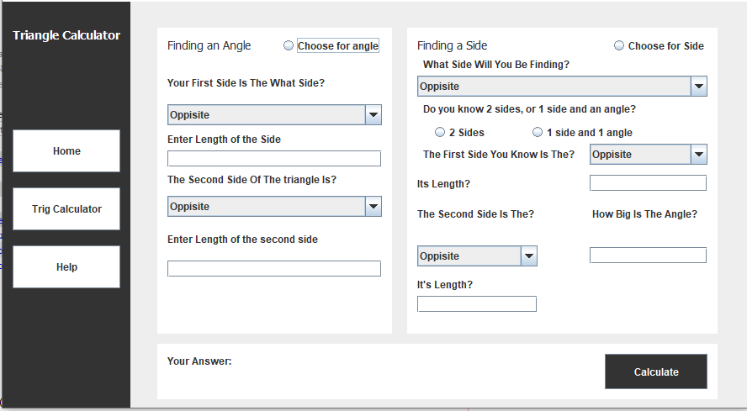
How it works - visually
-Top down
-Select radio buttons
-Choose information for your scenario
-input lengths
-hit calculate

Slide 8
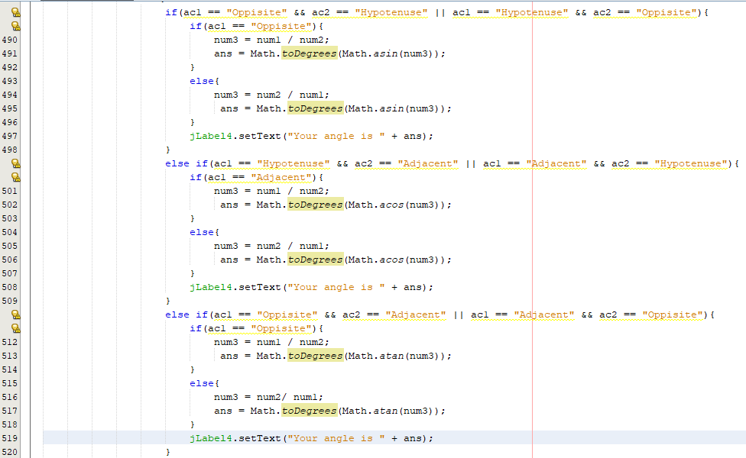
How it works – code
Takes the info
Determines choices
Calculates
Prints response

Slide 9
Why I chose this
I like java
Wanted to improve my ability to design and make frames
Different language than the other 2 projects

Slide 10
What it was suppose to be and what it became
was
now
Originally going to be more visual
Six buttons
And image swap
Photoshop to make
Going to have a position finder using unit circle
More adaptable to user situation
Added ability to find with all sides
Added to find angles

Slide 11
My Challenges and What I learned
How to design it
NetBeans and radio buttons using jframe
Trig does not work how you think it does in code

Slide 12
Project 2
Database

Slide 13
What is it?
Database created with SQL in mssms(Microsoft SQL Server Management Studio)
Simulate on a small scale of a business chains like Walmart or Target
Invoice
Employees
Inventory

Slide 14
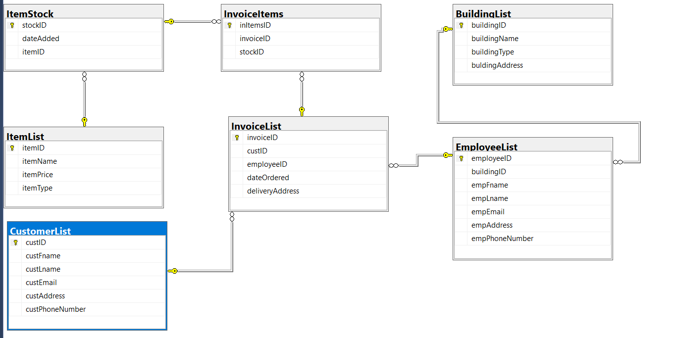
How I structured it
Building leads into employee
Item list leads to stock
And everything else leads into invoice lists and invoice items

Slide 15
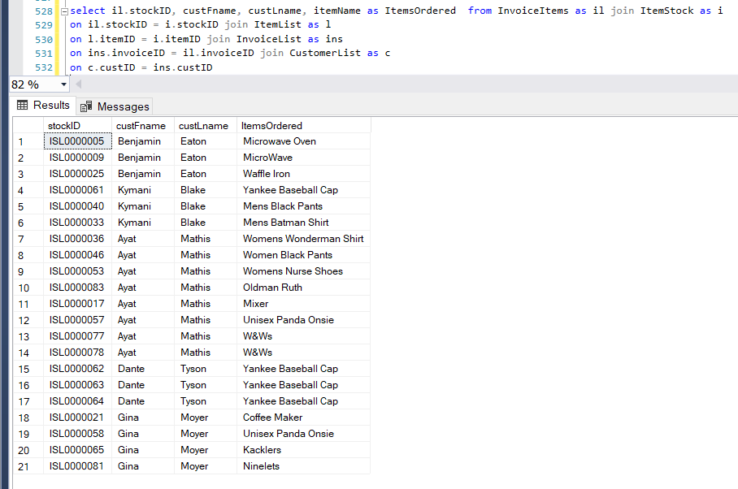
Example query
Query shows who ordered what item

Slide 16
Why I structured it like this
To have everything connect in some sort of way
Every branch somehow meet in invoice

Slide 17
What Changed from plan to finish
There was originally be more tables
Data in tables can multiply others
More data
Complex queires

Slide 18
What I learned from this?
Not much but!
Creating data table structure matters
Entering mass data is very time consuming

Slide 19
Project 3
Unity Game

Slide 20
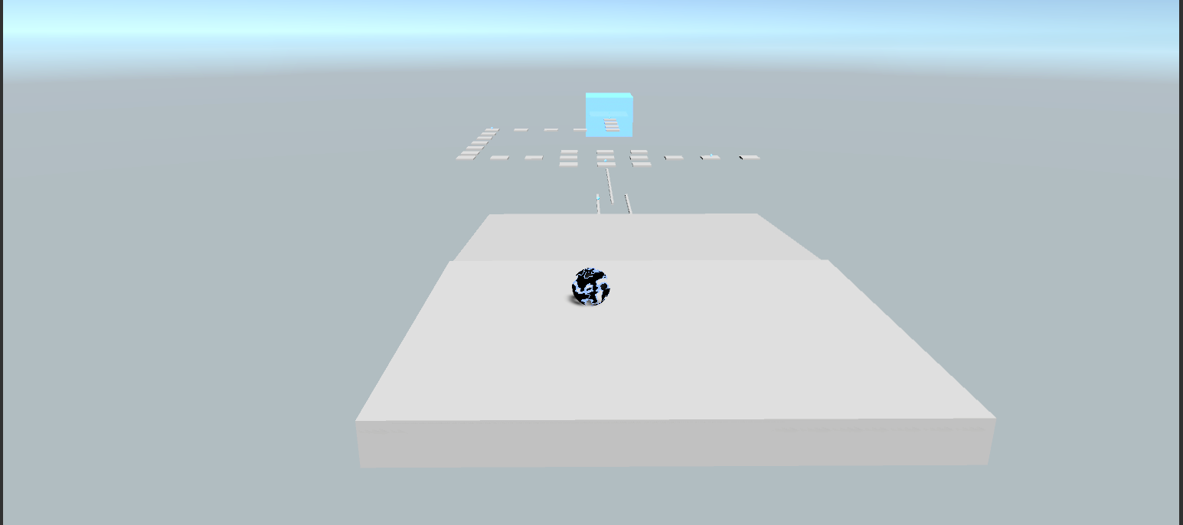
What is It?
Marble Parkour collection game.
Jump gaps and platforms, and collect cubes to continue and beat the level

Slide 21
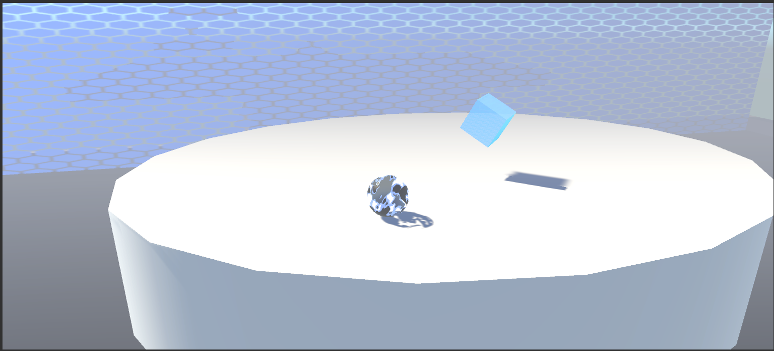
How to play it?
Use either the arrow keys or wasd( w a s, and d keys) to move.
Q key to jump
You can only jump once every 3 seconds
Space key to stop
Collect all holographic cubes
Some areas are blocked until you collect enough cubes
There are 3 levels
Easy
Medium
Hard

Slide 22

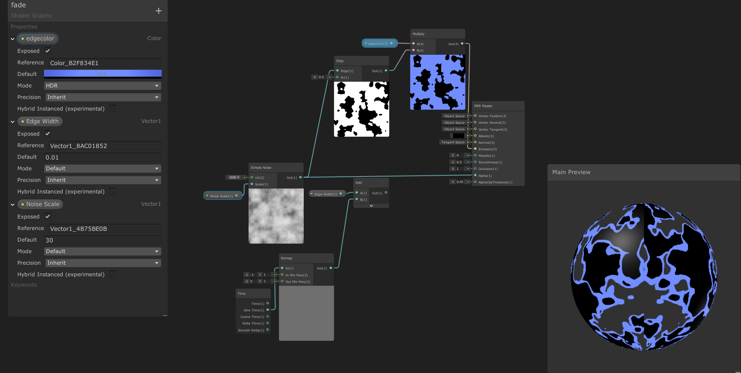
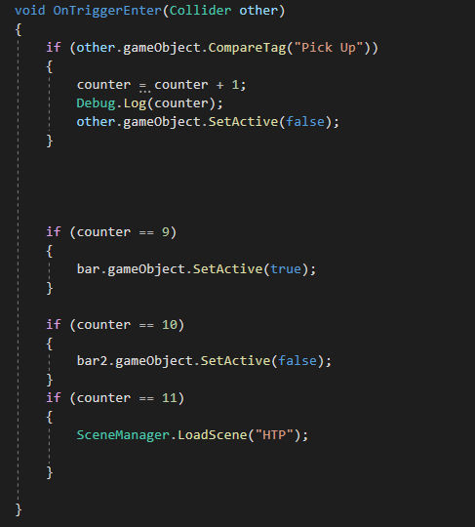
How it works
Each level is a scene each with its own scripts for each level
Easy- PlayerMovement
Medium - Level2
Hard – Level3
Cinema Machine is used for the camera to follow the player
The game was made using Unity Universal Render Pipeline
This adds an extra effect to light
Allows the use of shader graphs
Using a script to count how many cubes obtain an check to see if it is enough continue
If the player some how falls off when they fall to certain point they will be teleported back to start

Slide 23
What was challenging
Getting the player to move and a camera to follow properly
Understanding the Universal Render Pipeline
Using shader graphs
Cinema machine

Slide 24
What I learned
How to create event systems and effect your area
Vector’s
Shader graph
Nodes
Multiply
Add
Subtract
noise

Slide 25
Different Between draft and final
draft
final
Powerup
Breaks
difficulty

Slide 26
Sources
B. (2018). DISSOLVE using Unity Shader Graph. Brackeys. Retrieved 2020, from https://www.youtube.com/watch?v=taMp1g1pBeE&t=101s
B. (2019). FORCE FIELD in Unity - SHADER GRAPH. Brackeys. Retrieved 2020, from https://www.youtube.com/watch?v=NiOGWZXBg4Y
B. (2020). THIRD PERSON MOVEMENT in Unity. Brackeys. Retrieved May 24, 2020, from https://www.youtube.com/watch?v=4HpC--2iowE&t=634s

